Slide 1

National Association
of Farm Broadcasting
2021 Wave 4 Results
February 2022

Slide 2




A global, strategic intelligence firm empowering intelligence-driven organizations.
FUSION
We blend best practices from military intelligence and market research so our clients can make better decisions that reduce risk, optimize resources, and maximize success.
We are built on the foundational principals of military intelligence, as well as the understanding that food power is essential to national security.

Slide 3
202
Wave 1 - phone interviews
1/11/2021 – 1/23/2021
Research Approach
197
Wave 2 - phone interviews
4/6/2021 – 4/22/2021
Respondents have to be a primary/shared decision maker of a farming operation with GFI of $100K or more, have an ag radio station available, and listen to ag radio during the time of year interviewed.
200
Wave 3 - phone interviews
7/6/2021 – 7/30/2021
195
Wave 4 - phone interviews
10/25/2021 – 1/8/2022

Slide 4
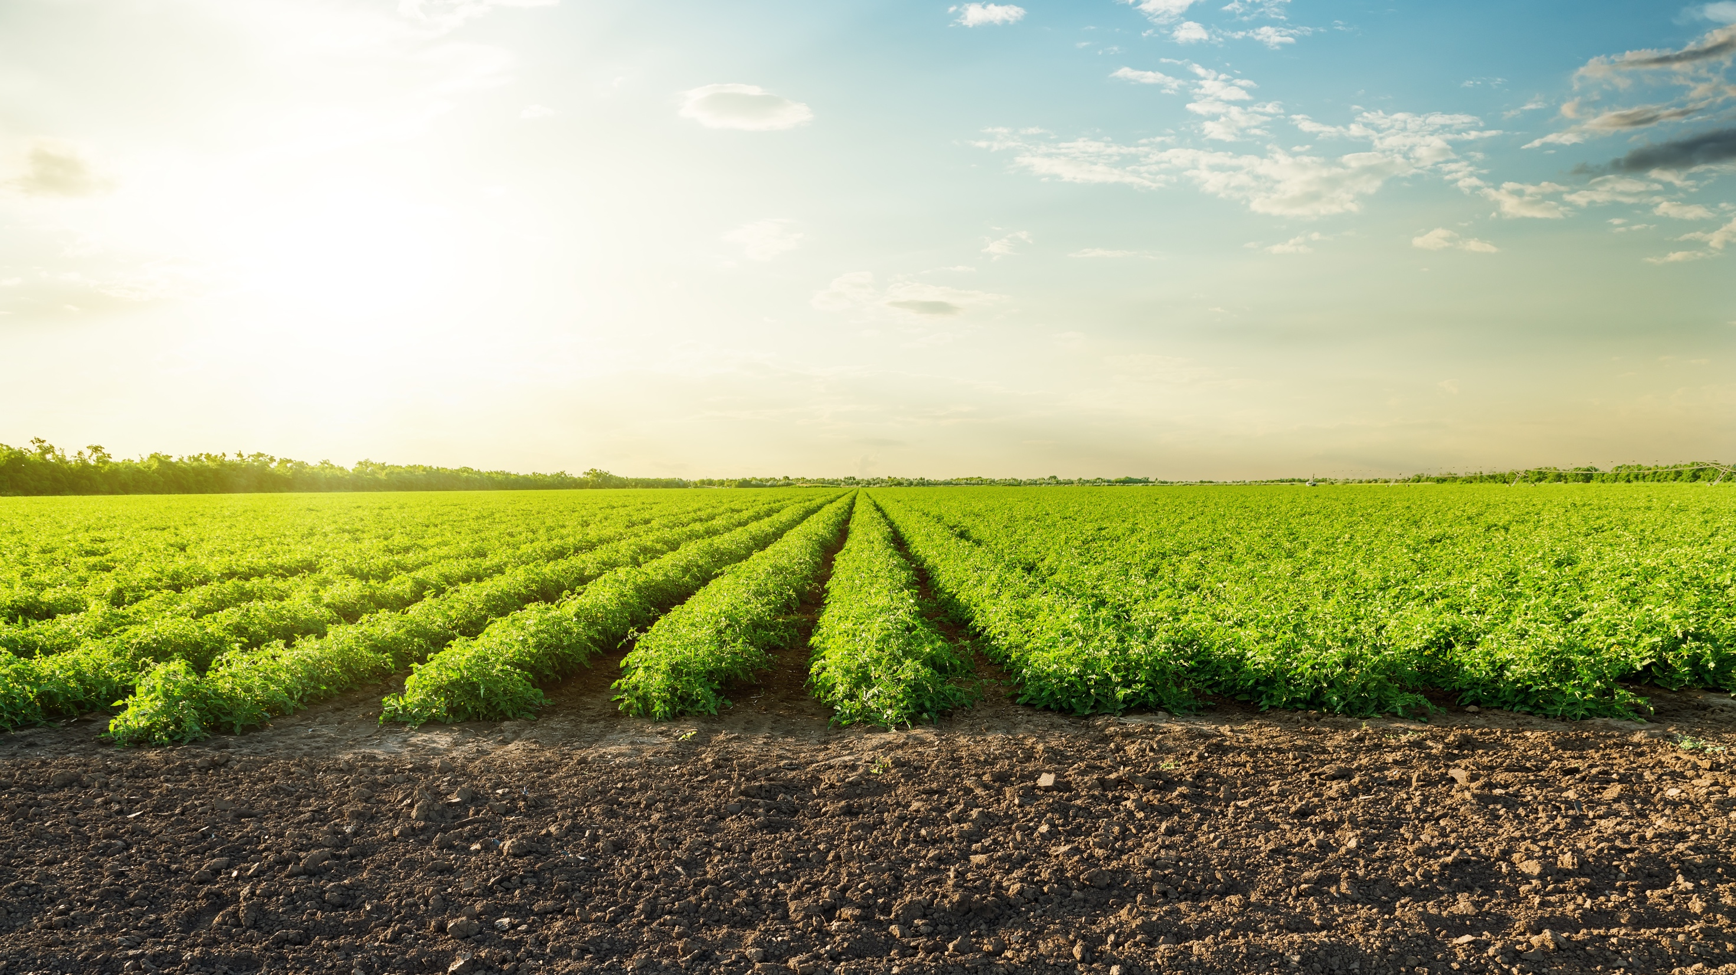

Profile of Respondents

Slide 5
Profile of Respondents
Source: Total farmers who listen to ag radio: Wave 1 (n=202), Wave 2 (n=197), Wave 3 (n=200), Wave 4 (n=195)
Which of the following best describes your role in decision making for your farming operation?

Slide 6
Profile of Respondents
Source: Total farmers who listen to ag radio: Wave 1 (n=202), Wave 2 (n=197), Wave 3 (n=200), Wave 4 (n=195)
Thinking of this past year, 2020, would you say your total farm revenues, from all sources, was:

Slide 7
Profile of Respondents
Average
57
56
57
58
Source: Total farmers who listen to ag radio: Wave 1 (n=202), Wave 2 (n=197), Wave 3 (n=200), Wave 4 (n=195)
What is your age?

Slide 8
Profile of Respondents
Average
1,099
1,919
1,906
2,286
Source: Total farmers who listen to ag radio: Wave 1 (n=202), Wave 2 (n=197) , Wave 3 (n=200), Wave 4 (n=195)
How many total acres did you plant in 2020?

Slide 9
Profile of Respondents
Plant crops
Wave 1
Wave 2
Wave 3
Wave 4
Source: Total farmers who listen to ag radio: Wave 1 (n=202), Wave 2 (n=197), Wave 3 (n=200), Wave 4 (n=195)
What crops did you plant in 2020?

Slide 10
Profile of Respondents
Livestock
Wave 1
Wave 2
Wave 3
Wave 4
Source: Total farmers who listen to ag radio: Wave 1 (n=202), Wave 2 (n=197), Wave 3 (n=200), Wave 4 (n=195)
Do you have any dairy or livestock in your operation?
What type of livestock?
Approximately how many head?

Slide 11
Radio Listenership

Slide 12
Radio listenership realizes a slight increase during the spring and summer. During this time of year, three out of four farmers tune in five or more days per week.
Average number of days per week listening to ag radio
% listening 5 or more days
68%
80%
76%
73%
Source: Total farmers who listen to ag radio: Wave 1 (n=202), Wave 2 (n=197), Wave 3 (n=200), Wave 4 (n=195)
Thinking of your radio listenership, typically how many days per week do you listen for farm news, weather, markets, and ag information during this time of year?

Slide 13
Ag/farm radio remains the primary source of daily ag news across all waves while ag/farm publications are not as utilized as previous waves.
Source: Total farmers who listen to ag radio: Wave 1 (n=202), Wave 2 (n=197), Wave 3 (n=200), Wave 4 (n=195)
During this time of year, what are your daily news sources for farm news, weather, markets, and ag information?

Slide 14
Listeners primarily use ag/farm radio as their daily news source. Multiple sources see lower engagement in Wave 3, and jump back up in Wave 4.
 | Wave 1 | Wave 2 | Wave 3 | Wave 4
Ag/farm radio | 71% | 76% | 79% | 79%
Ag/farm TV | 37% | 32% | 30% | 30%
Ag/farm publications | 25% | 42% | 13% | 23%
Blogs/websites/news | 15% | 10% | 18% | 10%
Ag/farm apps | 10% | 18% | 12% | 8%
Supplier/manufacturer text notifications | 8% | 17% | 11% | 14%
Social media | 9% | 18% | 9% | 15%
Company/industry websites | 5% | 15% | 8% | 6%
Supplier e-newsletter | 7% | 19% | 7% | 9%
Publication e-newsletter | 6% | 16% | 6% | 10%
Farm radio websites | 7% | 6% | 5% | 5%
Online farm forums | 11% | 15% | 5% | 14%
Ag/farm shows | 3% | 3% | 2% | 5%
Ag/farm podcasts | 4% | 7% | 1% | 3%
Other | 6% | 11% | 9% | 25%
None | 1% | 0% | 0% | 1%
Source: Total farmers who listen to ag radio: Wave 1 (n=202), Wave 2 (n=197), Wave 3 (n=200), Wave 4 (n=195)
During this time of year, what are your daily news sources for farm news, weather, markets, and ag information?

Slide 15
Daily engagement across multiple sources is highest for all groups, besides age 45-54, during Wave 2. Age 45-54 is highest in Wave 4.
Source: Total farmers who listen to ag radio: Wave 1 (n=202), Wave 2 (n=197), Wave 3 (n=200), Wave 4 (n=195)
During this time of year, what are your daily news sources for farm news, weather, markets, and ag information?

Slide 16
Ag radio listeners most often listen to AM and FM radio for ag information.
Radio bands
AM
FM
Satellite/
Sirius XM
Wave 1
Wave 2
Wave 3
Wave 4
Source: Total farmers who listen to ag radio: Wave 1 (n=202), Wave 2 (n=197), Wave 3 (n=200), Wave 4 (n=195)
On which of the following radio bands do you listen to farm news, weather, markets, and ag information during this time of year?

Slide 17
Of all those who have a satellite subscription, most have it in their work/farm pick-ups. Satellite subscription is highest during Wave 2.
Those who have
satellite subscription
Work/farm pick-up
Personal passenger vehicle
Ag equipment
Other
67%
66%
25%
5%
77%
72%
25%
2%
77%
55%
13%
11%
67%
61%
40%
10%
Source: Total farmers who listen to ag radio: Wave 1 (n=202), Wave 2 (n=197), Wave 3 (n=200), Wave 4 (n=195)
Do you have a paid subscription to satellite radio?
Source: Farmers who have satellite: Wave 1 (n=61), Wave 2 (n=81), Wave 3 (n=69), Wave 4 (n=74)
What vehicle(s) has an active, paid satellite radio account?

Slide 18
Listenership is highest during the early morning hours.
Early morning listenership increases with age across multiple waves.
Source: Total farmers who listen to ag radio: Wave 1 (n=202), Wave 2 (n=197), Wave 3 (n=200), Wave 4 (n=195)
When during the day do you listen to the radio for farm news, weather, markets, and ag information?

Slide 19
Minutes spent listening remains consistent throughout the year.
Average
69
70
64
67
Source: Total farmers who listen to ag radio: Wave 1 (n=202), Wave 2 (n=197), Wave 3 (n=200), Wave 4 (n=195)
On a typical weekday during this time of year, how many minutes do you spend listening to farm news, weather, markets, and ag information?

Slide 20
Of all farmers who listen to ag programming on Saturdays, a large portion listen before Noon.
Listenership of ag
programming on Saturday
6-9 a.m.
9 a.m.-Noon
Noon-
4 p.m.
after 4 p.m.
62%
26%
20%
7%
62%
37%
18%
11%
64%
41%
23%
15%
60%
38%
22%
12%
Source: Total farmers who listen to ag radio: Wave 1 (n=202), Wave 2 (n=197), Wave 3 (n=200), Wave 4 (n=195)
During this time of year do you listen to farm news, weather, markets, and ag information programming on Saturday?
Source: Total farmers who listen to ag radio on Saturdays: Wave 1 (n=117), Wave 2 (n=130), Wave 3 (n=109), Wave 4 (n=97)
On a typical Saturday during this time of year, at what time of day do you typically listen to farm news, weather, markets, and ag information programming on the radio?

Slide 21
Throughout most of the year approximately six in ten farmers who listen to ag radio on Saturdays do so for at least 30 minutes.
Average
43
58
46
42
Source: Total farmers who listen to ag radio: Wave 1 (n=117), Wave 2 (n=130), Wave 3 (n=109), Wave 4 (n=97)
On a typical Saturday during this time of year, how many minutes do you spend listening to farm news, weather, markets, and ag information programming on the radio?

Slide 22
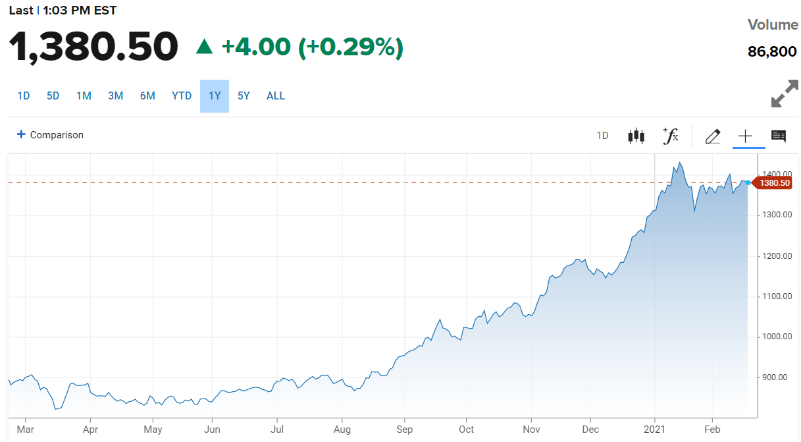
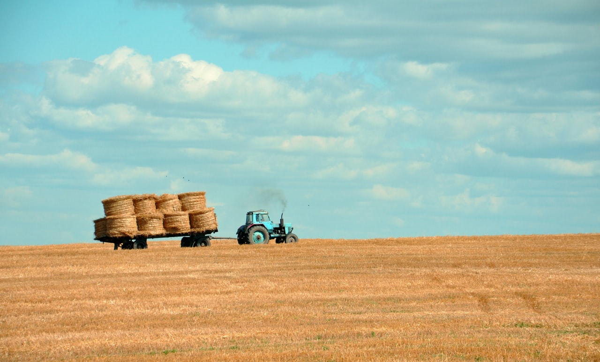
Listeners report receiving a wide variety of topical information from ag radio; however, they are primarily listening to/for ag markets and commodity prices, weather, and local/regional ag news.
Source: Total farmers who listen to ag radio: Wave 1 (n=202), Wave 2 (n=197), Wave 3 (n=200), Wave 4 (n=195)
What types of information do you get when you listen to your local farm broadcaster?

Slide 23
The average number of types of information listened to by farmers generally varies by age group throughout the year but is between about 3 and 5.
Types of information – information received from broadcaster: ag markets/commodity prices, ag weather,
local/regional ag news, world ag/trade news, farm commentary, insights from Washington, D.C./policy updates, new products, agriculture innovation, and other
Source: Total farmers who listen to ag radio: Wave 1 (n=202), Wave 2 (n=197), Wave 3 (n=200), Wave 4 (n=195)
What types of information do you get when you listen to your local farm broadcaster?

Slide 24
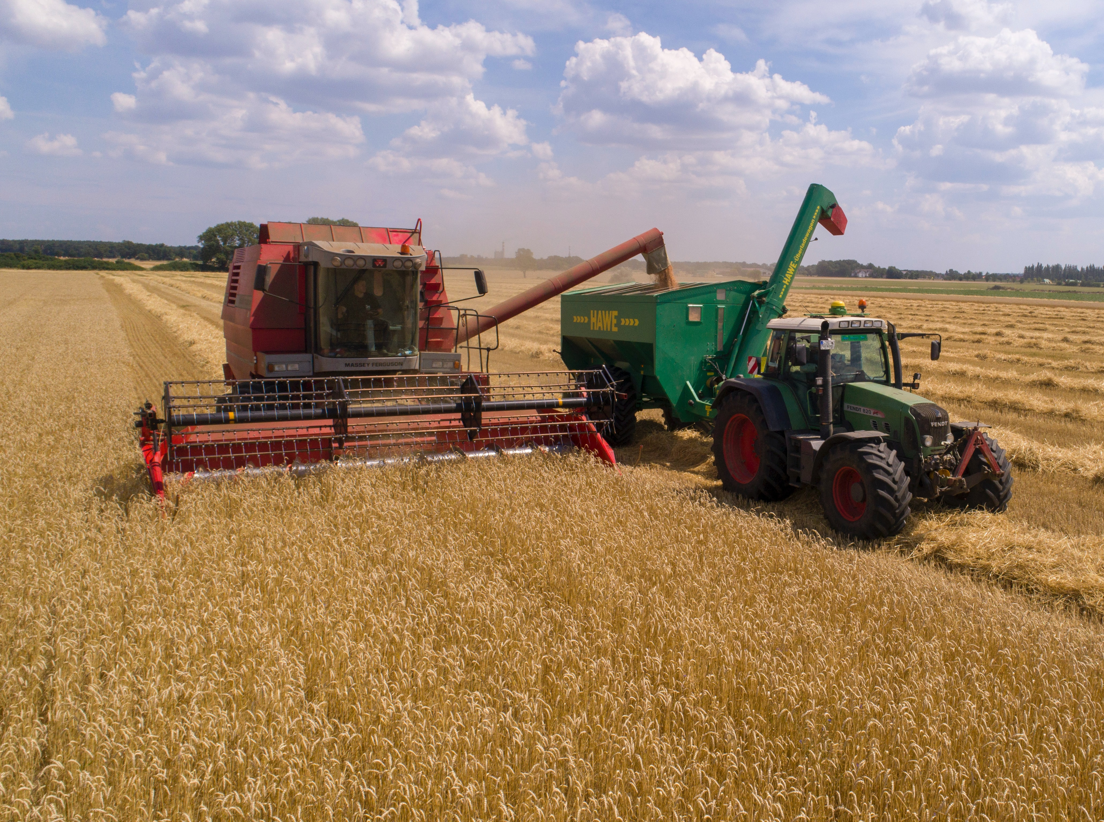
Ag radio is most often listened to by farmers while driving their vehicles and/or operating farm equipment.
Source: Total farmers who listen to ag radio: Wave 1 (n=202), Wave 2 (n=197), Wave 3 (n=200), Wave 4 (n=195)
Where do you listen to farm news, weather, markets, and ag information on the radio at this time of year?

Slide 25
Farm Broadcaster Perceptions

Slide 26
Farm broadcaster ratings are consistently favorable wave over wave.
Farm broadcaster ratings
Is credible
8.27
8.25
8.13
8.21
Provides accurate info
8.39
8.38
8.21
8.46
Provides timely info
8.05
8.11
8.01
8.22
Source: Total farmers who listen to ag radio: Wave 1 (n=202), Wave 2 (n=197), Wave 3 (n=200), Wave 4 (n=195)
Thinking of the farm broadcaster who delivers farm news, weather, markets, and ag information, please rate them on a scale of 1 to 10, where 10 is excellent and 1 is very poor, on the following factors:

Slide 27
Conversely, national media outlets are generally not regarded as credible, accurate, or timely.
National media outlet ratings
4.28
3.67
3.72
4.15
Is credible
Provides accurate info
4.50
3.69
3.86
4.27
Provides timely info
5.26
4.67
4.69
5.07
Source: Total farmers who listen to ag radio: Wave 1 (n=202), Wave 2 (n=197), Wave 3 (n=200), Wave 4 (n=195)
Thinking of national news media outlets, such as NBC, CBS, ABC, New York Times, etc., please rate them on a scale of 1 to 10, where 10 is excellent and 1 is very poor, on the following factors:

Slide 28
Podcasts

Slide 29

Over half of farmers surveyed have ever listened to a podcast. Listenership of a podcast in the past month is lower in Waves 3 and 4.
Within past
6 months
More than
6 months ago
Ever listened to a podcast
Today
This week
This month
7%
17%
12%
12%
5%
8%
16%
18%
19%
7%
9%
11%
11%
19%
7%
5%
12%
13%
17%
8%
Source: Total farmers who listen to ag radio: Wave 1 (n=202), Wave 2 (n=197), Wave 3 (n=200), Wave 4 (n=195)
Have you ever listened to a podcast on any topic?
When was the last time you listened to a podcast on any topic?

Slide 30
A quarter of all farmers surveyed have listened to a podcast on an agricultural topic within the last month.
Ever listened to an ag podcast
Today
This week
This month
Within past
6 months
More than
6 months ago
4%
12%
13%
11%
5%
1%
14%
15%
21%
7%
6%
7%
12%
21%
6%
4%
11%
10%
15%
8%
Source: Total farmers who listen to ag radio: Wave 1 (n=202), Wave 2 (n=197), Wave 3 (n=200), Wave 4 (n=195)
Have you ever listened to a podcast about an agricultural topic?
When was the last time you listened to a podcast on an agricultural topic?

Slide 31
Other Sources

Slide 32
A large portion of farmers who listen to ag radio tune into ag related television throughout the year.
Source: Total farmers who listen to ag radio: Wave 1 (n=202), Wave 2 (n=197), Wave 3 (n=200), Wave 4 (n=195)
Do you watch television for any ag-related programming and information during this time of year?

Slide 33
Ag television viewers watch ag programming most during Waves 1 & 4, time in which farmers are less likely to be in-field.
Average
41
33
33
36
Source: Total farmers who listen to ag radio: Wave 1 (n=140), Wave 2 (n=117), Wave 3 (n=112), Wave 4 (n=117)
How many minutes a day would you say you watch ag programming on television?

Slide 34
Farmers are online looking for farm news, weather, markets, and ag information throughout the day, most notably in the mornings and evenings.
Source: Total farmers who listen to ag radio: Wave 1 (n=202), Wave 2 (n=197), Wave 3 (n=200), Wave 4 (n=195)
During a typical day, at what times are you online looking for farm news, weather, markets, and ag information?

Slide 35



Facebook and YouTube are used by about half of farmers on a typical day.
Spend one or more minutes in typical day
Source: Total farmers who listen to ag radio: Wave 1 (n=202), Wave 2 (n=197), Wave 3 (n=200), Wave 4 (n=195)
On a typical day during this time of year, how many minutes do you spend on each of the following?

Slide 36
Key Findings
This research showcases the value farmers place on ag radio. During the busy summer months, ag/farm radio is a source for a wider variety of information.
Ag news listenership is highest in the early morning hours, particularly among farmers age 65 or older.
Local ag broadcasters are highly rated among farmers. Listeners see their broadcasters as credible, accurate, and timely all year round. Farmers are increasingly looking to local farm broadcasters for world ag/trade news, farm commentary, and insights from D.C.
Ag/farm radio is a reliable source for advertisers and marketers throughout all seasons of the year for distributing ag-related information to reach farmers of all sizes.

Slide 37
Recommendations
Messaging toward farmers ages 65+ should occur in the morning programming. Advertising targeting this demographic for programs featured throughout the day may expand listening time.
Maintain a social media presence via Facebook and YouTube to continue and broaden engagement with younger farmers.
Consider adding questions to better understand streaming habits. Streaming may be a way to reach younger farmers.
Consider adding additional questions around seasonality to understand what farmers are doing that impacts ag/farm radio listenership.

Slide 38
Appendix

Slide 39
Outside of the Midwest, ag radio is less available and there is less engagement.
Wave 1 results
Source: Midwest contacts (n=248); West contacts (n=86); South contacts (n=132); Northeast contacts (n=59)
Is there a radio station available to you with farm news, weather, markets, and ag information?
Do you listen to farm news, weather, markets, and ag information on the radio during this time of year?

Slide 40


Profile of Respondents
Regions
 | Wave 1 | Wave 2 | Wave 3 | Wave 4
Midwest | 68% | 62% | 68% | 70%
Northeast | 8% | 9% | 8% | 7%
South | 13% | 15% | 13% | 12%
West | 11% | 14% | 11% | 12%
WA
ME
VT
MT
ND
NH
MA
OR
MN
NY
Wave 1
9%
90%
ID
SD
WI
MI
RI
CT
WY
PA
NJ
Wave 2
4%
95%
IA
OH
DE
NE
IL
IN
MD
NV
UT
WV
VA
Washington D.C.
Wave 3
3%
97%
CA
CO
KS
MO
KY
NC
TN
SC
Wave 4
10%
89%
AZ
NM
OK
AR
GA
MS
AL
TX
LA
FL

Slide 41
Over a quarter of surveyed farmers are listening to their local farm broadcasters on a medium besides radio.
Source: Total farmers who listen to ag radio: Wave 1 (n=202), Wave 2 (n=197), Wave 3 (n=200), Wave 4 (n=195)
At this time of year, do you listen to your local farm broadcaster on a medium besides radio? (streaming, podcast, web videos, etc.)

Slide 42



