Slide 1
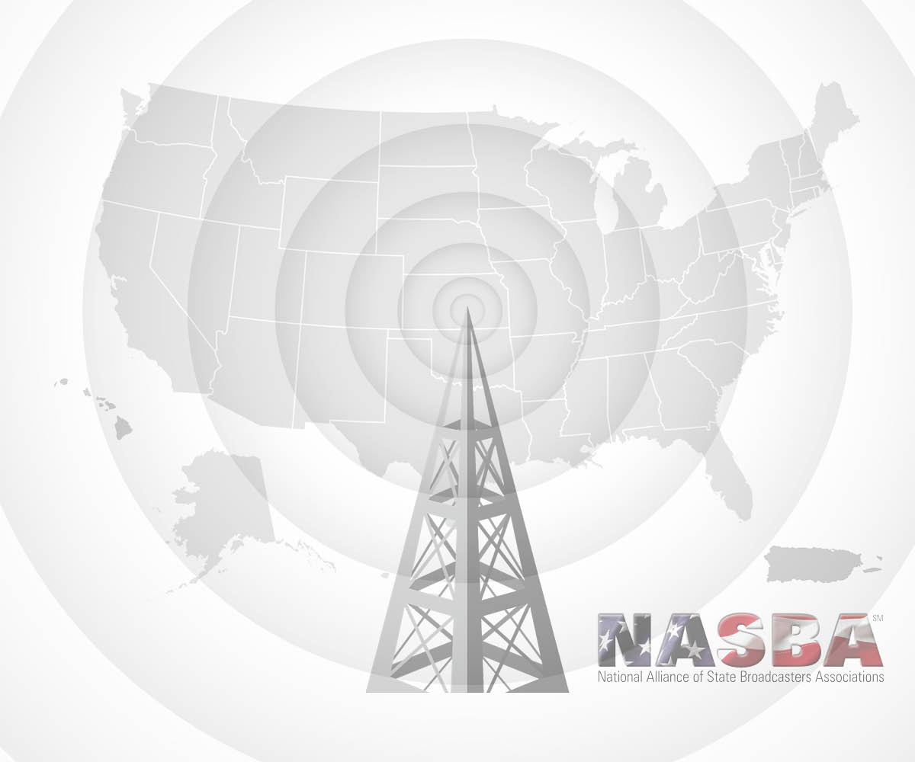

Public Education Partnership
Enhanced national and multi-state outreach campaigns for
government agencies and non-profit organizations

Slide 2
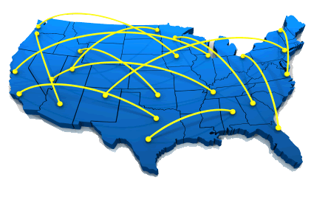
The Challenge:
You need to provide public outreach and market your agency or organization in a way that you are guaranteed coverage on a nationwide or regional basis
You need to do it in the most cost
effective way possible
You would like to use the most powerful
local medium available, that has
universal reach throughout the
nation or throughout a region

Slide 3
Solution:
Public Education Partnership (PEP)
  Connects public service campaigns by government agencies and non-profit entities with the public through radio and television broadcasters
  Recognized by the
  Federal Communications
  Commission
  Effectively used by numerous
  government agencies and nonprofit
  organizations across the country for more
  than 20 years

Slide 4
What is PEP?
A program coordinated by the National Alliance of State Broadcasters Associations (NASBA)
Specifically designed to make nationwide radio and television advertising affordable for government agencies, non-profit, trade associations and organizations supporting public education campaigns

Slide 5

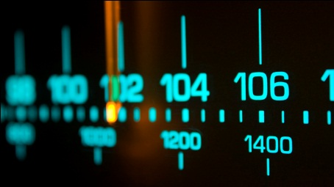
PEP: An Alliance with Universal, Nationwide and Regional Coverage
Comprised of over:
  6000 Radio Stations
  1200 Television Stations
In all 50 states, Washington DC and Puerto Rico
The perfect vehicle to cost effectively reach out to all listeners and viewers across the country or throughout a region with compelling marketing messages

Slide 6

PEP Advantages:
Unique alternative to the uncertainty of
Public Service Announcement placement
A fraction of the cost of traditional advertising
No one else can provide government agencies
and non-profit organizations national reach with a guaranteed
minimum return of four dollars in media value to every dollar invested
Full documentation of all broadcasts

Slide 7

Local Broadcasting is Ubiquitous
In the crowded media landscape local radio and television stations stand out as an integral part of the communities they serve
TV dominates video viewing
with a 95% share*
Radio reaches 91% of the audience
12 and older every week**
Broadcasters have the power to inform, entertain, provide critical information and updates during emergencies and rally local communities to support those in need
*Source Nielsen’s Q3 2015 Total Audience Report
**Source: RADAR ® 127, December 2015 (C) Copyright Nielsen Audio (Monday-Sunday 24-Hour
Weekly Cume Estimates, All Radio)

Slide 8
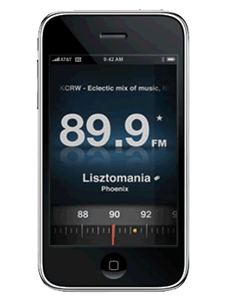
Local Radio & TV Reaches All Americans on Every Media Platform
Radio - Universal reach
  91% of all Americans tune into their
  favorite radio station at least once a week
  Purchasing radio advertising guarantees
  access on new mobile platforms
    AT&T, Sprint and T-Mobile activated FM
    radio receiving chips in their mobile
    smartphones
    Stations are streaming on-air content to all platforms
    Large radio companies have “apps” allowing local radio stations to be accessed on all mobile devices

Slide 9

Local Radio & TV Reaches All Americans on Every Media Platform
Television – Universal Reach
  Local stations can be seen by all
  cable and satellite subscribers
  on the low cost basic tier
  About 19.3% of US homes
  (59.7 million people) see TV
  through an antenna and do not
  subscribe to cable or satellite pay
  TV services*
  Local stations are deploying their own mobile platforms
  *National Association of Broadcasters citing
  GFK Insights, Home Technology Monitor 2013

Slide 10


Proven Record of Success
National Campaigns
  Army National Guard has used the program for nearly 20 years
  Highly successful in meeting its recruiting mission
Regional Campaigns
  In 2013-14 Health and Human Services used the
  program to educate residents of 12 states
  on the Affordable Care Act enrollment period
    1543 radio & 272 television stations used
    Broadcast 142,000 radio & television
    messages over 5 month period
    Value - More than 4:1 ratio
State Campaigns
  Our associations assist state agencies with hundreds of
  PEP campaigns every year

Slide 11
PEP Documentation
Documented coverage and performance using recognized monitoring services such as Nielsen
  List of stations broadcasting the messages
  Number of messages broadcast
  Time of day spots aired
  Dollar value of airtime
  Reports generated monthly or quarterly
Additional reporting from smaller,
non-monitored markets

Slide 12
Additional Details:
Contracted on a nationwide, regional or multi state basis.
One stop shopping – NASBA is responsible for all aspects of program
Campaigns begin at any point,
typically three month increments
Only government agencies, non-profits,
trade associations & organizations supporting
public service campaigns may use PEP
Campaigns may not be advocacy related

Slide 13
Conclusion:
PEP is the most effective way for a government agency or non-profit organization to reach all listeners and viewers with guaranteed coverage on a nationwide or regional basis, using the most powerful media in America – local radio and TV broadcasting

